Slide 1
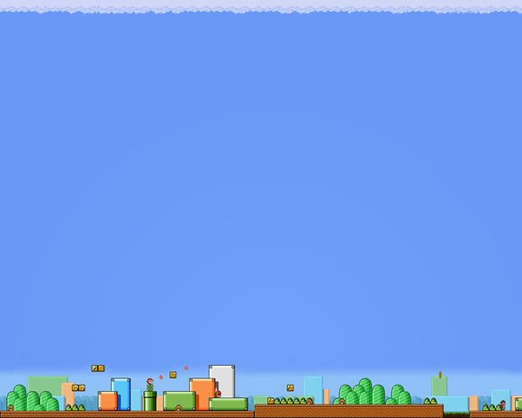
PROJECT: CAR GAME
Team members:
1. KASHIFA KAWAAKIB HUSSAIN (180041227)
2. IFRAD TOWHID KHAN (180041225)
3. MD. SHAKIB UR RAHMAN (180041211)
1

Slide 2
CONTENTS:
Motivation
Objectives
Basic concept
Features
How we met our objectives
Timeline
Problems we faced
Future works
2

Slide 3
BASIC CONCEPT:
Basically it’s a car game where the main target is to dodge the oncoming cars that comes from the opposite side.
3

Slide 4
MOTIVATION:
Firstly, we chose to make a game because a game is something which was and will always be a point of our interest. So, working with one’s own field interest makes it easier to gain motivation and focus more in it.
Secondly, we chose a car game in particular because it would allow us to add features as we like and use our creativity to enhance the project.
4

Slide 5
OBJECTIVES:
Learn graphics.
Learn to use different functions of c programming.
Learn various use of different external and internal header files and libraries.
Gain better knowledge about how simple games are made and the algorithms used in different car games.
5

Slide 6
FEATURES:
The game is made in c programming language.
At first the player has to choose an option among start game, controls and exit in the starting interface.
The car can be controlled with the arrow keys and it can move in every direction.
The player has to dodge the cars coming from the opposite side.
6

Slide 7
The player will gain 1 point for dodging each car.
The cars coming from the opposite direction are generated randomly by the computer.
While playing the game, the difficulty level will be increased from time to time by increasing the speed of the oncoming cars and also the speed of the player’s car itself.
If the car collides with any of the enemy cars or the side of the road, the game is over.
7

Slide 8
HOW WE MET OUR OBJECTIVES:
We were able to learn how a simple game can be made using c graphics and simply the c programming language.
We were able to understand how various functions in c graphics can be used through some research and with a lot brainwork.
We now have a better idea about algorithms used in simple games.
8

Slide 9
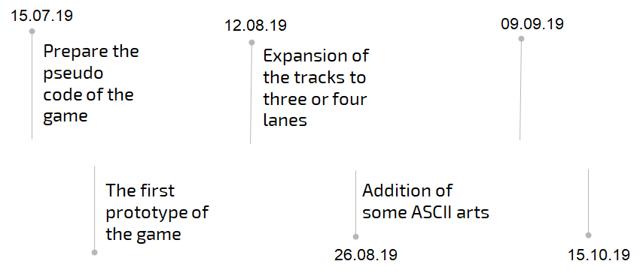

Timeline before:
Debugging and
Testing
10
29.07.19

Slide 10
We already made a version of this game in the console four weeks earlier. But then we changed our plan and we again made the game with graphics.
So from that previous version of the game we
Gained better knowledge about array
Learnt to add Ascii arts in the console
Learnt to play sound and many other functions
11

Slide 11
Timeline after:
16.09.19
14.10.19
Learn graphics in c language
Debugging and testing
Plan the program and start implementing it
Final submission
12
20.10.19
15.10.19

Slide 12
PROBLEMS WE FACED:
C graphics was something completely new and we needed to learn it in a short time.
Due to shortage of time we could only work on integrating graphics into our program in the last four weeks of the project.
13

Slide 13
FUTURE WORKS:
Making the player lose one ‘life’ each time the car crashes with another car instead of ending the game.
Changing the environment on either side of the road as the game progresses.
Options will be added to select car from multiple cars and each car will have distinct abilities.
14

Slide 14
Thank you
15

